Slide 1
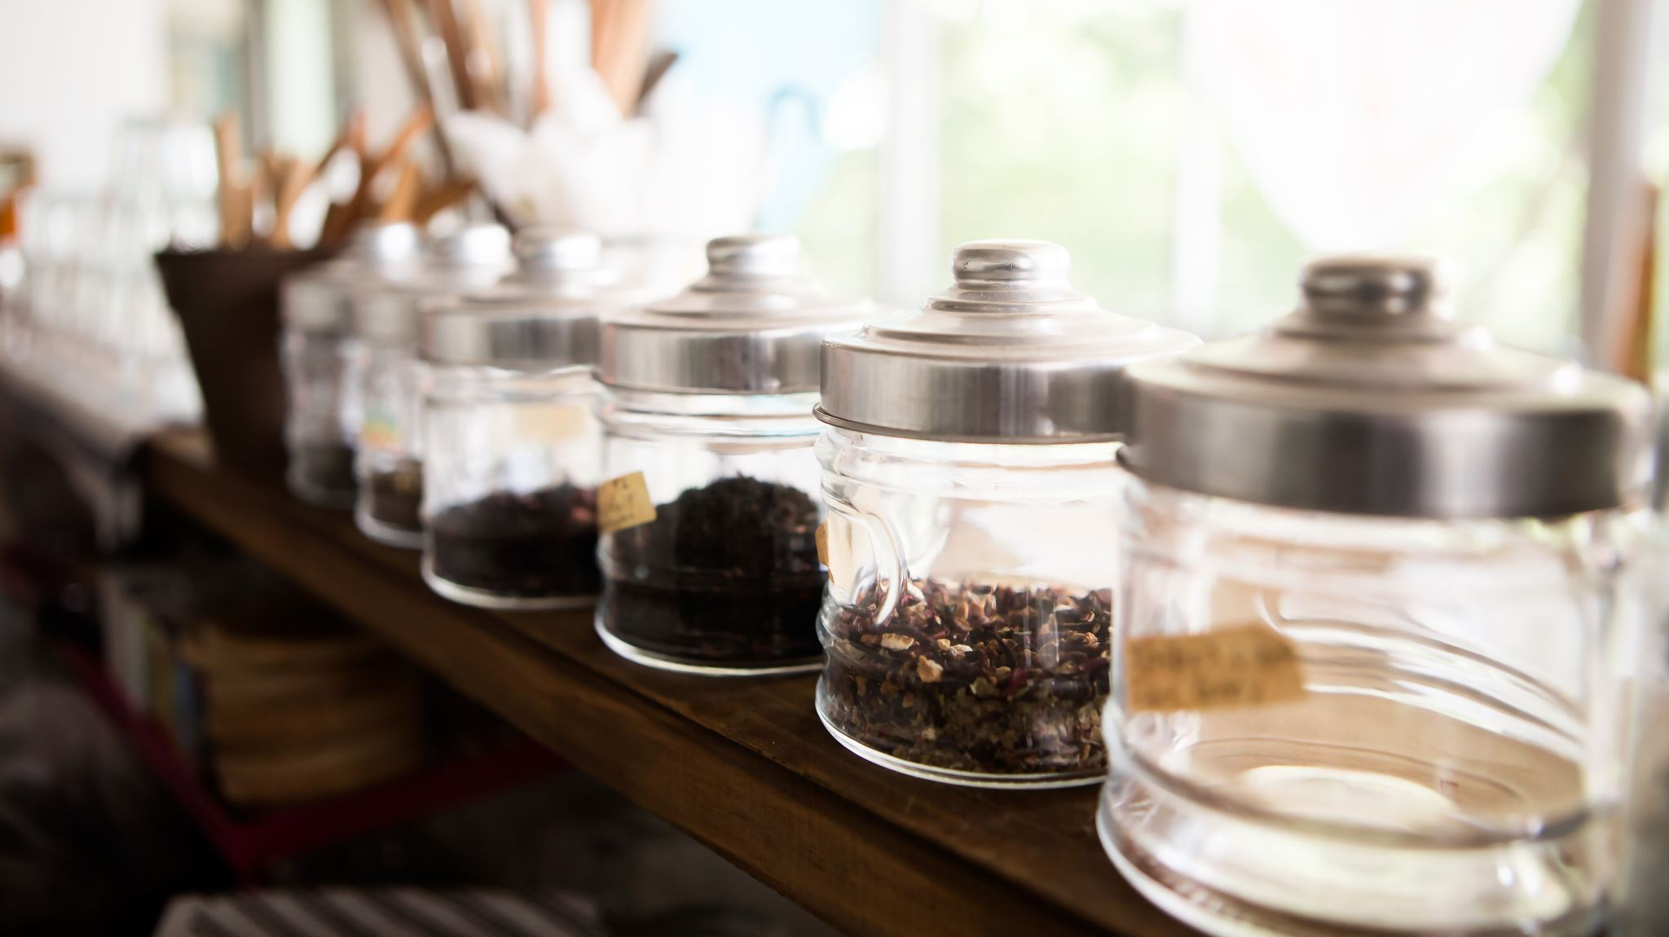
Opening a Coffee Shop
WITH SOME HELP FROM the Foursquare API and Python

